Slide 1


PREDICTING TEMPERATURES USING LINEAR REGRESSION
Group 7:
Meher Upadhyay
Rodrigo Martins
Onyekachi Ohiaeri
Daniel Terach

Slide 2
Technologies used:
Python - Programming language
Jupyter Notebook – Interactive computing environment that contains live code
NumPy - Library that supports functionality and mathematical operations for multi-dimensional arrays
Pandas - Library used for data manipulation and analysis
Matplotlib and Seaborn - Libraries used for mathematical plotting and embedding plots
Scikit-learn - Machine learning library that encompasses regression algorithms. It has some useful methods that we used in our project, such as:
Train Test Split
Linear Regression
Accuracy Score
Cross Val Score
R2 Score
Mean Squared Error
Confusion Matrix
Classification Report

Slide 3
Step by Step Analysis:
Import Libraries (Pandas, NumPy, Matplotlib, Seaborn and Scikit-learn)
Load and Analyze the Data using methods: head(), describe(), info(), isna().sum(), shape
Check the correlation between variables using method corr()
Use Histogram and Scatter Plots to visualize the correlation between variables
Choose variable X and y and Split into Train and Test Data sets
Create the Linear Regression model and make predictions
Show the results of the model using methods:
accuracy_score()
cross_val_score()
intercept_
coef_
mean_squared_error()
r2_score()
confusion_matrix()
classification_report()

Slide 4
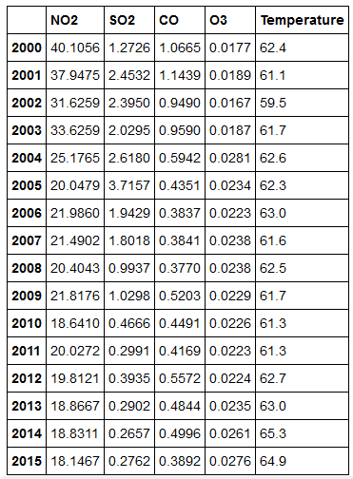
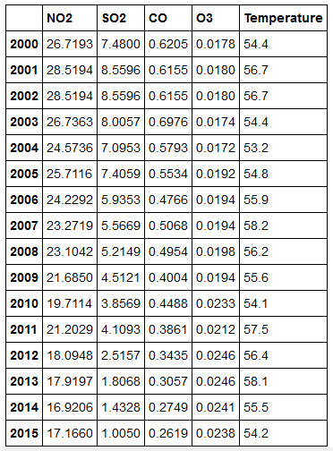
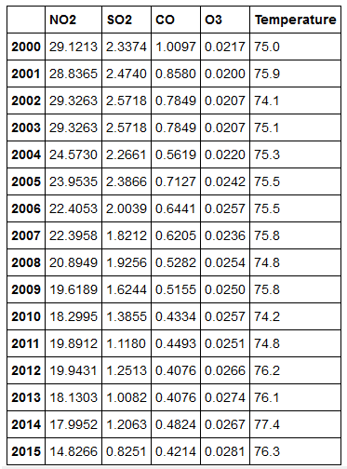
We used 3 datasets of different cities:
Datasets links:
https://www.kaggle.com/sogun3/uspollution
https://www.kaggle.com/sudalairajkumar/daily-temperature-of-major-cities
Los Angeles
New York
Phoenix
PS: Datasets are modified after cleaning process done to Midterm presentation

Slide 5
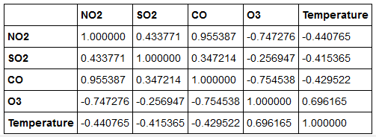
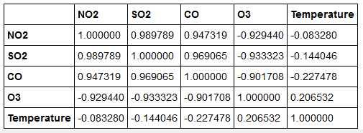
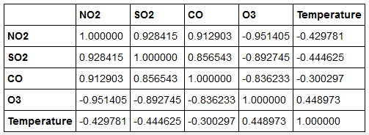
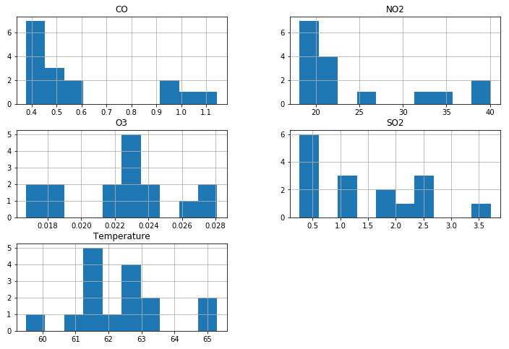
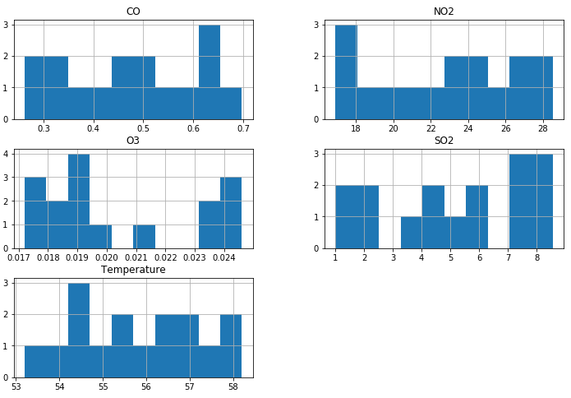
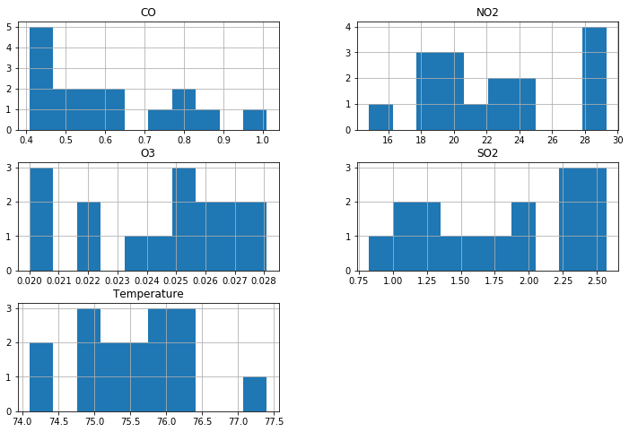
Checking the relation between data:
Los Angeles
New York
Phoenix

Slide 6
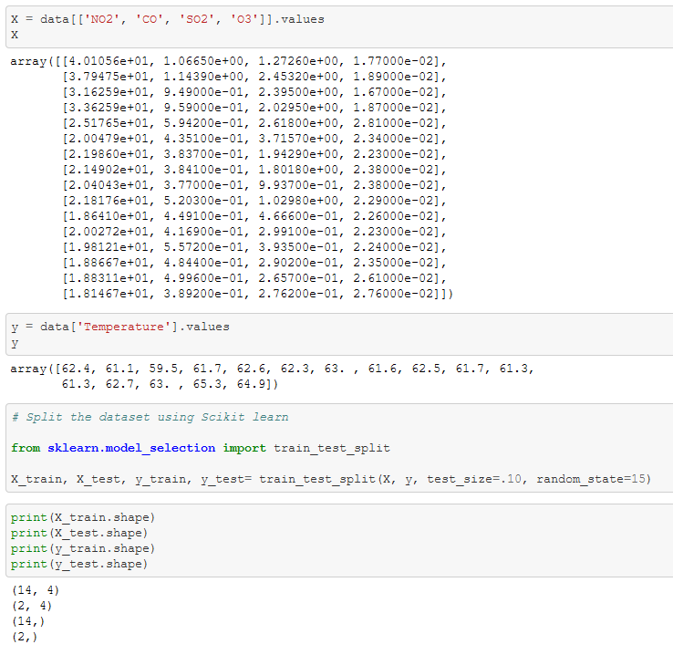

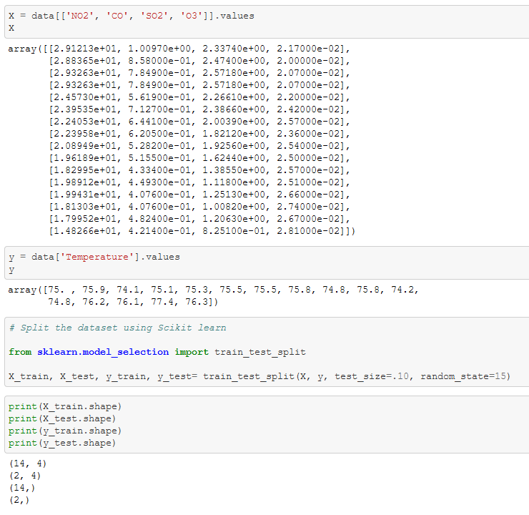
Splitting the Data using Scikit-learn method train_test_split():
After the analysis of the correlation between the data, we decided to use the variable X and y as follows:
The variable X (predictor or independent variable): NO2, SO2, CO and O3
The variable y (response or dependent variable): Temperature
Los Angeles
New York
Phoenix

Slide 7
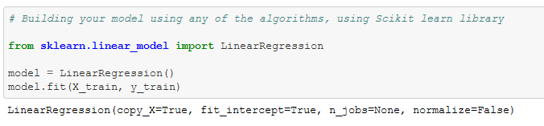
Regression is a statistical method used to determine the relationship between one dependent variable (usually denoted by y) and a series of other variables (known as independent variables, usually denoted as X).
There are two types of Regression:
Simple: uses one independent variable to explain or predict the outcome of the dependent variable Y;
Multiple: uses two or more independent variables to predict the outcome.
In our project we used Multiple Regression since we used 4 variables as the X variable.
The general form of the Multiple Linear Regression is: Y = a + b₁X₁ ⁺ b₂X₂ + b₃X₃ + ... + b_{t}X_{t} + u, where:
Y = the variable that we are trying to predict (dependent variable).
X = the variable that we are using to predict Y (independent variable).
a = the intercept.
b = the slope.
u = the regression residual.
We will show the result of the model after making predictions.
Creating the LINEAR REGRESSION Model:

Slide 8
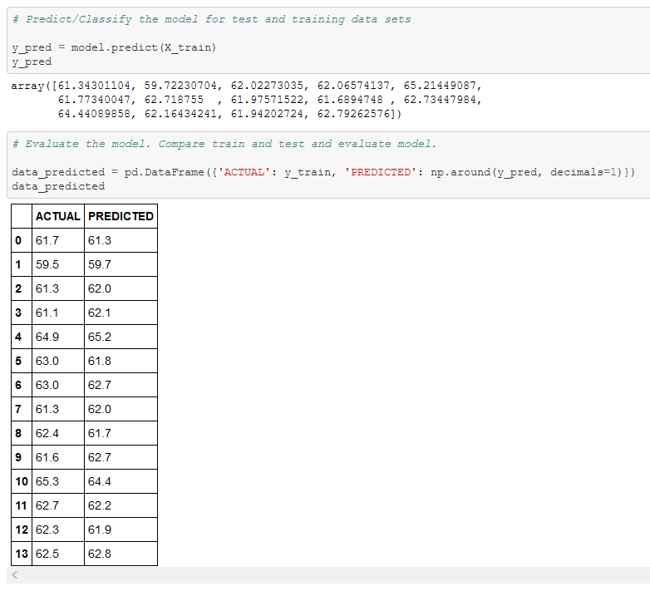
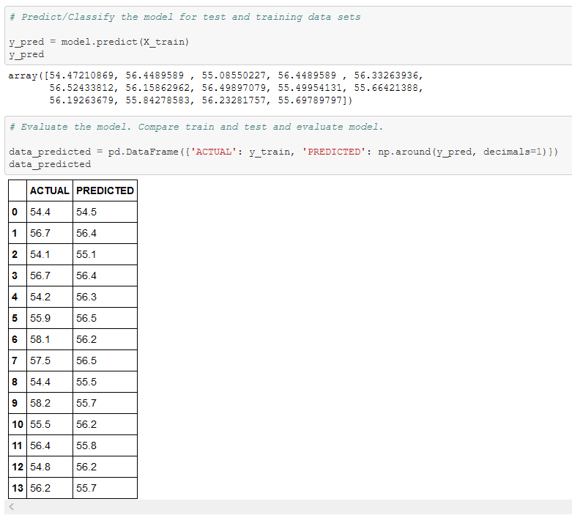
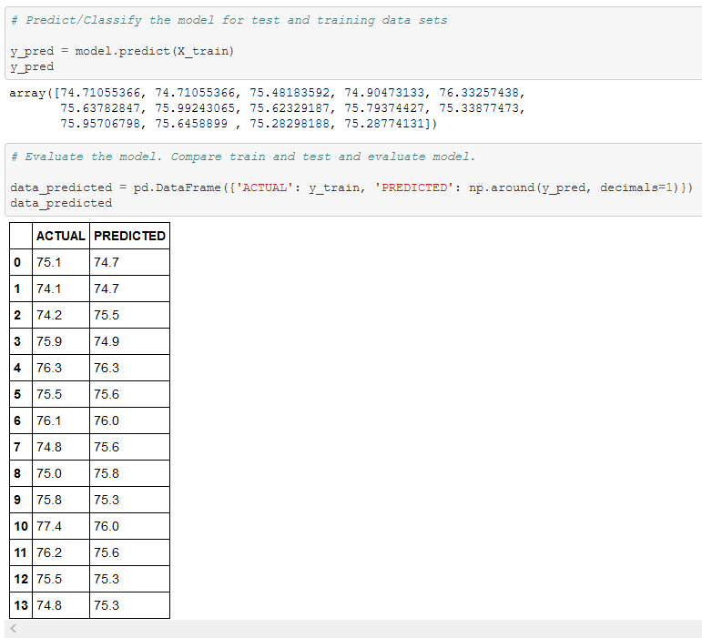
Predicting / Classifying the model:
Los Angeles
New York
Phoenix

Slide 9
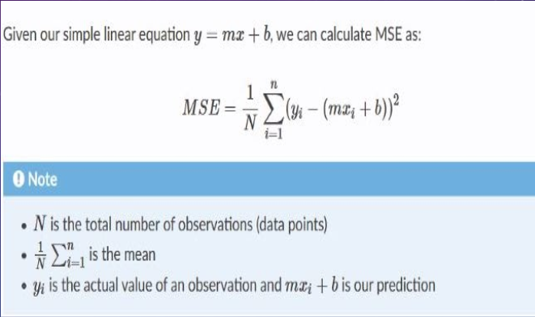
As we know, MSE (Mean Square Error) measures the average squared difference between an observations actual and predicted values. The output is a single number representing the cost or score.
N is the total number of climate temperatures we have in our data set for each city (16)
(1/N) 𝚺 (n, i=1) is the average temperature (summation of avg temperature of each year / 16)
Yi is the actual value given to us by the data set
Mx + b is the graphical line representing the predictions
The alignment of this prediction line to the actual line is a depiction of how accurate our model is and how low our MSE is.
Cost Function of Dataset:

Slide 10
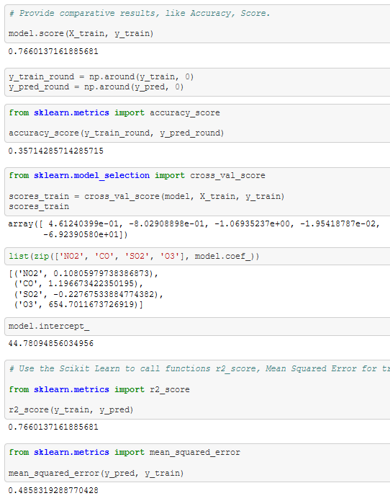
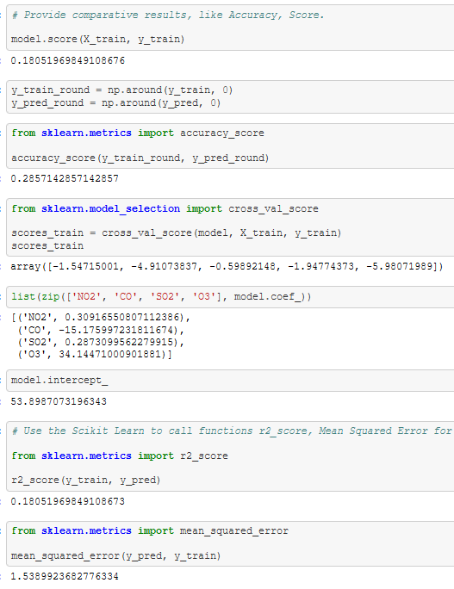
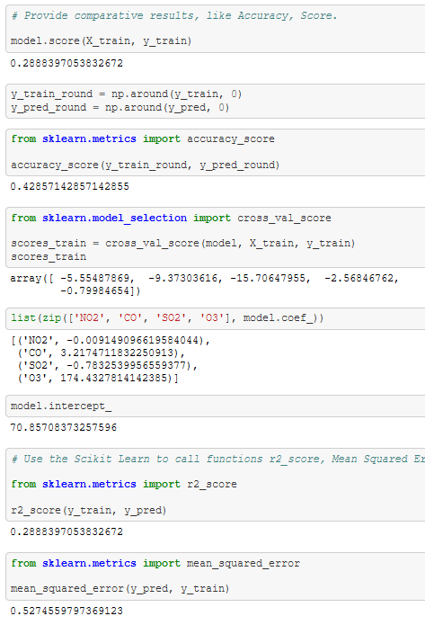
Providing comparative results of the model:
Los Angeles
New York
Phoenix

Slide 11
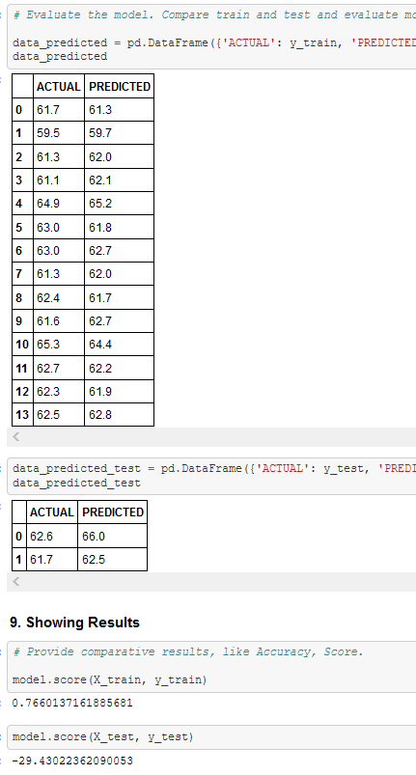
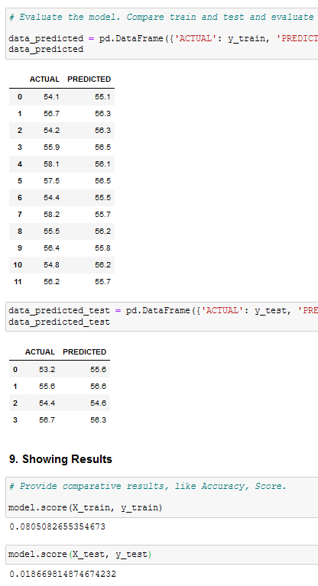
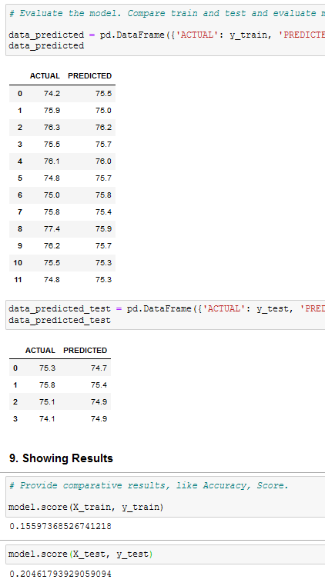
Comparing Train and Test dataset and evaluating model
Los Angeles
New York
Phoenix

Slide 12
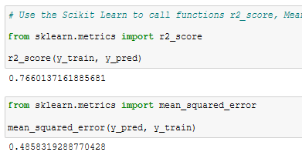
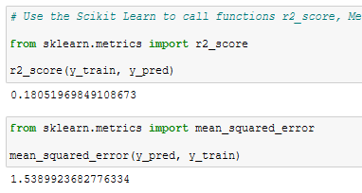
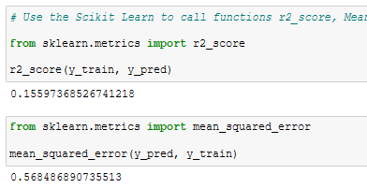
Using the Scikit-learn library to call functions r2_score and mean_squared_error to evaluate the dataset
The "coefficient of determination" or "r-squared value," denoted r², is the regression sum of squares divided by the total sum of squares. So here our one variable is temperature of cities and another variable is the gases of the same cities.
The coefficient of determination, R2, is used to analyze how differences in one variable can be explained by a difference in a second variable.
As given below the r2 score differs from city to city.:
Los Angeles: 0.76 New York: 0.18 Phoenix: 0.15
Los Angeles
New York
Phoenix

Slide 13
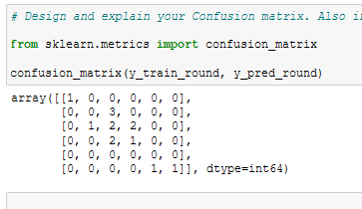
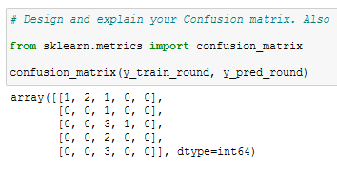
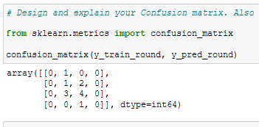
Design and explain the Confusion Matrix inferring if the model is overfitting or underfitting
A simple way to layout how many predicted categories or classes were correctly predicted and how many were not.
The blue highlighted predictions in the confusion matrix are the true positive, yellow are true negative, green is false positive and pink is false negative.
Los Angeles
New York
Phoenix
1 | 0 | 0 | 0 | 0 | 0
0 | 0 | 3 | 0 | 0 | 0
0 | 1 | 2 | 2 | 0 | 0
0 | 0 | 2 | 1 | 0 | 0
0 | 0 | 0 | 0 | 0 | 0
0 | 0 | 0 | 0 | 1 | 1
1 | 2 | 1 | 0 | 0
0 | 0 | 1 | 0 | 0
0 | 0 | 3 | 1 | 0
0 | 0 | 2 | 0 | 0
0 | 0 | 3 | 0 | 0
0 | 1 | 0 | 0
0 | 1 | 2 | 0
0 | 3 | 4 | 0
0 | 0 | 1 | 0

Slide 14
Thank You!!!

